Slide 1
PA#1
A secure “pay-per-view” real-time media streaming system

Slide 2





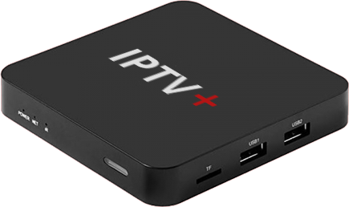



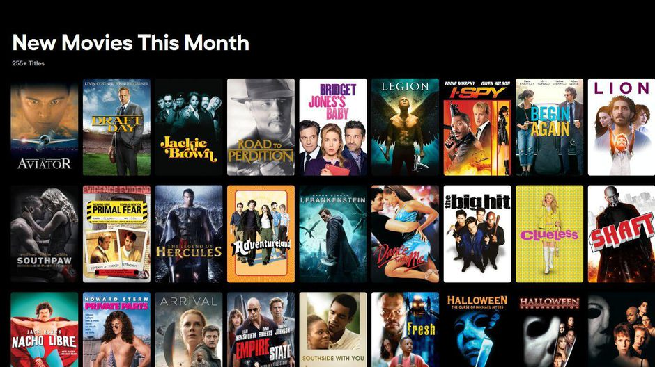
System Model
Cloud-Provided Pay-Per-View Streaming as a Service
Registered
Users &
ProxyBoxes
Users in a Domestic
Environment and
ISP Access
(LAN/WLAN and
Internet Access)
SAPKDP PROTOCOL
Signaling
Server
Movie
Security
Associations
SRTSP Protool
ProxyBox
Streaming
Server
Internet
(Public
Addressing)
Private
Network
IP PRIVTE ADDRESSING

Slide 3
System Model: Functional Architecture
Registered
Users &
ProxyBoxes
User PWD
SAPKDP PROTOCOL
Signaling
Server
Movie
Security
Associations
SRTSP Protool
Private
Network
ProxyBox
Streaming
Server
Internet
(Public
Addressing)
IP PRIVTE ADDRESSING
TRUSTED COMPUTING ENVIRONMENT
and TRUSTED PRIVATE NETWORK
TRUSTED COMPUTING ENVIRONMENT
and TRUSTED PRIVATE NETWORK

Slide 4

System Model and Trust Model
Registered
Users &
ProxyBoxes
User PWD
SAPKDP PROTOCOL
Signaling
Server
Movie
Security
Associations
SRTSP Protool
Private
Network
ProxyBox
Streaming
Server
Internet
(Public
Addressing)
IP PRIVTE ADDRESSING
TRUSTED COMPUTING ENVIRONMENT
and TRUSTED PRIVATE NETWORK
TRUSTED COMPUTING ENVIRONMENT
and TRUSTED PRIVATE NETWORK
ADVERSARIAL CONDITIONS

Slide 5
Adversary Model
Communication
Endpoints
X509 Framework Attack Types
Considered:
Identity and IP Spoofing or
Maquerading
(Peer-Authenticity Breaks)
Data-Leakage
(Confidentiality Breaks)
Message/DataFlows
Authenticity Breaks
Message/DataFlows Tampering
(Integrity Breaks)
Can do Traffic Analysis
Out of the Adversary Model Scope
DoS, DDoS
Ex:
Network Congestion and/or Saturation
Availability and Correctness of Endpoints
“Man in The Middle”
Opponents
SAPKDP PROTOCOL
SRTSP Protool
Internet
ADVERSARIAL CONDITIONS

Slide 6
The protocols involved
SAPKDP
Secure Authentication, Payment and Key-Distribution Protocol
Can be implemented over UDP, TCP or HTTP (you can choose the encapsulation in your design and implementation)
Important: for the PA#1 delivery you will not use TLS or HTTPS – anyway the protocol will be secure by design and implementation
Optionally and later on … you can support it over TLS, DTLS or HTTPS if you want !
SRTSP
Secure Real Time Streaming Protocol
Must be implemented over UDP !

Slide 7
System Model & Setup
Crypto
Configs
Registered
Users &
ProxyBoxes
User PWD
SAPKDP PROTOCOL
Signaling
Server
Movie
Security
Associations
SRTSP Protool
ProxyBox
Streaming
Server
.dat (movies)
FFMPEG—Like Encoded
Crypto
Configs
ADVERSARIAL CONDITIONS
Crypto
Configs

Slide 8
System Model & Setup
Crypto Configs
(ex., SigS Crypto Keystore)
Crypto
Configs
CryptoCoins
(… or)
eVouchers
Registered
Users &
ProxyBoxes
User PWD
SAPKDP PROTOCOL
Signaling
Server
Movie
Security
Associations
SRTSP Protool
ProxyBox
Streaming
Server
ProxyBox PubKey
.dat (movies)
FFMPEG—Like Encoded
ProxyBox PrivKey
Crypto Configs
(ex., ProxyBox Keystore)
Crypto Configs
(ex., StreamS Keystore)
Crypto
Configs

Slide 9
System Model
Crypto Configs
(ex., SigS Crypto Keystore)
CryptoConf
UsersPoxies.conf
Registration File
(Config. File,
txt File)
CryptoCoins
(… or)
eVouchers
SS PublicKey
User PWD
SAPKDP PROTOCOL
Signaling
Server
CipherMovies.conf
(Config. File
txt File
FFMPEG
Streaming
SRTSP Protool
ProxyBox
SRTSP Encrypted Streaming
Streaming
Server
ProxyBox PubKey
.dat Files (movies)
FFMPEG4-Type Encoded
Crypto Configs
(ex., ProxyBox Keystore)
Crypto Configs
(ex., StreamS Keystore)
CryptoConf

Slide 10
SADKDP Functional Discussion (Specification formalized in a specific reference doc)

Slide 11
System Model: The SAPKDP Protocol
Crypto Configs
(ex., SigS Crypto Keystore)
CryptoConf
UsersPoxies.conf
Registration File
(Config. File,
txt File)
SS PublicKey
Usernane
ProxyBoxID
PWD
SAPKDP Protocol
Signaling
Server
CipherMovies.conf
(Config. File
txt File
ProxyBox
CryptoCoins
(… or)
eVouchers

Slide 12
The SAPKDP Protocol
Crypto Configs
(ex., SigS Crypto Keystore)
CryptoConf
UsersPoxies.conf
Registration File
(Config. File,
txt File)
Usernane
ProxyBoxID
PWD
PrivateKey
SS PublicKey
SAPKDP Protocol
Signaling
Server
CipherMovies.conf
(Config. File
txt File
Hi, I am userX,ProxyBoxID
ProxyBox
CryptoCoins
(… or)
eVouchers

Slide 13
The SAPKDP Protocol
Crypto Configs
(ex., SigS Crypto Keystore)
CryptoConf
UsersPoxies.conf
Registration File
(Config. File,
txt File)
Usernane
ProxyBoxID
PWD
PrivateKey
SS PublicKey
SAPKDP Protocol
Signaling
Server
CipherMovies.conf
(Config. File
txt File
OK, here you have a NONCE challenge
a SALT and a Counter for you PBE Proof
ProxyBox
CryptoCoins
(… or)
eVouchers

Slide 14
The SAPKDP Protocol
Crypto Configs
(ex., SigS Crypto Keystore)
CryptoConf
UsersPoxies.conf
Registration File
(Config. File,
txt File)
Usernane
ProxyBoxID
PWD
PrivateKey
SS PublicKey
SAPKDP Protocol
Signaling
Server
CipherMovies.conf
(Config. File
txt File
Here you have my PBE Auth Proof
I want to see the Movie “CARS”, can I ?
ProxyBox
CryptoCoins
(… or)
eVouchers

Slide 15
The SAPKDP Protocol
Crypto Configs
(ex., SigS Crypto Keystore)
CryptoConf
UsersPoxies.conf
Registration File
(Config. File,
txt File)
Usernane
ProxyBoxID
PWD
PrivateKey
SS PublicKey
SAPKDP Protocol
Signaling
Server
CipherMovies.conf
(Config. File
txt File
Yes you can … must pay 1 cryptocoin
Here you have another NONCE
Send the valid payment and sign your
pay-per-view order (with your valid
digital signature)
ProxyBox
CryptoCoins
(… or)
eVouchers

Slide 16
The SAPKDP Protocol
Crypto Configs
(ex., SigS Crypto Keystore)
CryptoConf
UsersPoxies.conf
Registration File
(Config. File,
txt File)
Usernane
ProxyBoxID
PWD
PrivateKey
SS PublicKey
SAPKDP Protocol
Signaling
Server
CipherMovies.conf
(Config. File
txt File
This is my signed transaction of
1 crypticoin for the payment
… You can validate the payment
Is correct and valid
ProxyBox
CryptoCoins
(… or)
eVouchers

Slide 17
The SAPKDP Protocol
Crypto Configs
(ex., SigS Crypto Keystore)
CryptoConf
UsersPoxies.conf
Registration File
(Config. File,
txt File)
Usernane
ProxyBoxID
PWD
PrivateKey
SS PublicKey
SAPKDP Protocol
Signaling
Server
CipherMovies.conf
(Config. File
txt File
OK, the payment is verified and it
is correct
I am sending all the info your need for the
movie you want, protected and just for you and
signed by me :
ENDPOINT (IP & Port)
ciphersuite conf
cryptograhic materials ad keys
Opaque Info (encrypted ticket> you must send
to the stream server
ProxyBox
CryptoCoins
(… or)
eVouchers

Slide 18
Use model: The SRTSP Protocol
Registered
Users &
ProxyBoxes
Usernane
ProxyBoxID
PWD
Configuratuion Files
Signaling
Server
Movie
Security
Associations
SRTSP Protool
ProxyBox
CryptoCoins
(… or)
eVouchers
Streaming
Server
.dat Files (movies)

Slide 19
SRTSP Functional Discussion (Specification formalized in a specific reference doc)

Slide 20
The SRTSP Protocol
Hy Streaming Server …
I want ti see the movie CARS
You have here an Opaque Ticket for
You (I obtained from the Signaling Server)
It was delivered just for me by the Signalling Server,
to forward it for you
And as you can verify, I am sending this signed by me
Usernane
ProxyBoxID
PWD
ProxyBox
Streaming
Server
.dat Files (movies)

Slide 21
The SRTSP Protocol
Usernane
ProxyBoxID
PWD
Ok, From my verifucation, it is fine
… Here is the confirmation that everything is ok
Are you ready to receive ?
See that this is signed by me
If it is ok, send me am ACK to this “nonce challenge”
ProxyBox
Streaming
Server
.dat Files (movies)

Slide 22
The SRTSP Protocol
Usernane
ProxyBoxID
PWD
Yep, I recognize your signature …
I send the answer to your challenge …
So Yep we are now eager, ready, with our
“popcorns” ready to start playing!
ProxyBox
Streaming
Server
.dat Files (movies)

Slide 23
The SRTSP Protocol
Usernane
ProxyBoxID
PWD
First synchconization encrypted packet
OK, ... Here we go !
ProxyBox
Streaming
Server
.dat Files (movies)

Slide 24
The SRTSP Protocol and Real-Time Playing
<plain frame packets>
Usernane
ProxyBoxID
PWD
<encryted frame packet>
ProxyBox
Streaming
Server
.dat Files (movies)

Slide 25
Implementation
Ref. Evaluation
PA#1 developed in 3 Stages: Step 1 (or STAGE 1) Initial Approach to a “simplified” version of SRTSP Protocol No Signaling Server, No SAPKDP Protocol, no Coins and no PayPerView
Step 2 (or subsequent STAGE 2)
Signaling Server
SAPKDP
SRTSP
(SAPKDP and SRTSP Complete Integration and everything else)
12/20 Points
~8-12 / OCT
(Prelim. Demos on LABs
15-17 / OCT)
20/20 Points
Delivery + Quiz: Ref: 24/NOV

Slide 26
“Hands On”: Here you go: Stage 1 ! (Simple SRTSP Version and simplified vision of the desired system)

Slide 27
STEP 1 Implementation

Slide 28
Your first step challenge (suggestion)
Start with the SRTSP Protocol
A direct “step” forward to the provided material (Lab 3, Streaming and Materials)
You have Movies (.dat) and the initial (unsecure) StreamingServer and Proxy implementation
Ready to be used (unsecurely)!
You can develop the ProxyBox and StreamingServer extending the provided implementations
You have the base materials and of course the VLC tool
Can start by using “static” configurations
Configuration files manually installed in ProxyBOX and Streaming Server
The SRTSP for the streaming phase only requires Symmetric Crypto and MACs
BUT the USABLE CRYPROGRAPHY MUST BE CONFIGURABLE !!!!
Later on, the static configurations must be removed after the complete implementation of the SRTSP and SAPKDP protocols, as well as the Signaling Server

Slide 29
The “simplified” SRTSP Protocol for Real-Time Playing
CIpherMovies
Config File
<plain frame packets>
Shared between the
StreamingServer and
The ProxyBox
Manual
Installation
(setup)
Manual
Instalation
(setup)
ProxyBox
<encryted frame packet>
Streaming
Server
Network Endpoints
<IP, port> Configuration
.dat Files (movies)

Slide 30
Initial static configuration for the SRTSP Protocol and its implementation in the Streaming Server and in the ProxyBox
Can choose any valid “static” configurations
CRYPTOGRAPHICALLY CONFIGURABLE !!!!
Later on (Next Steps), this file will be not shared between the Streaming Serve and the ProxyBox
The setup will be dynamic after the complete implementation of the SRTSP and SAPKDP protocols, as well as the Signaling Server

Slide 31
Simplified version of SRTSP and SRTSP encapsulation over UDP and Datagram Packets
SRTSP Header contains:
4 bits: contains the version id of the Simplified SRTSP protocol: 0001
4 bits: contains an indication that the setup is manual: 0000 means manual configuration of endpoints
16 bits: integer, contains the size in bytes of the encapsulated encrypted frame
Encrypted Frame (variable size)
MAC (variable size)
SRTSP Header
SRTSP protected FFMPEG Frame
MAC Integrity Check
UDP Header
UDP Payload Data

Slide 32
For this week ! (1)
Try to address the first proposed challenge (STEP 1) for he SRTSP
You only need to start form the materials you already have
StreamingServer
Proxy
Try to avoid complexity in the base StreamingServer and Proxy
You must implement with a modular approach !
Extend the DatagramSocket or Datagram Packet Classes
Ex: MySRTSPDatagramSocket ….. MySRTSPDatagramPacket
The minimum number of lines changed in the StreamingServer and Proxy Class, the better and more moduar will be you first solution
VERY IMPORTANT FOR THE NEXT PHASE !

Slide 33
For this week (2)
Try to avoid complexity in the base StreamingServer and Proxy
You must implement with a modular approach !
Extend the DatagramSocket or Datagram Packet Classes
Ex: MySRTSPDatagramSocket ….. MySRTSPDatagramPacket
The minimum number of lines changed in the StreamingServer and Proxy Class, the better and more moduar will be you first solution
VERY IMPORTANT FOR THE NEXT PHASE !
How Many LoC do you have in your Secure Proxy and Secure Stream Server implementation ? +/- 10% diff max. comparing w/ the original code ?
Is your configuration neutral ? Can we use any cuphersuite configuration ?

